Slide 1



waves: light and sound
Experience 2: Explore how we use light and sound waves to communicate.
BOCES 4 Science Website: https://sites.google.com/wflboces.org/boces4science/home
Grade 1

Slide 2
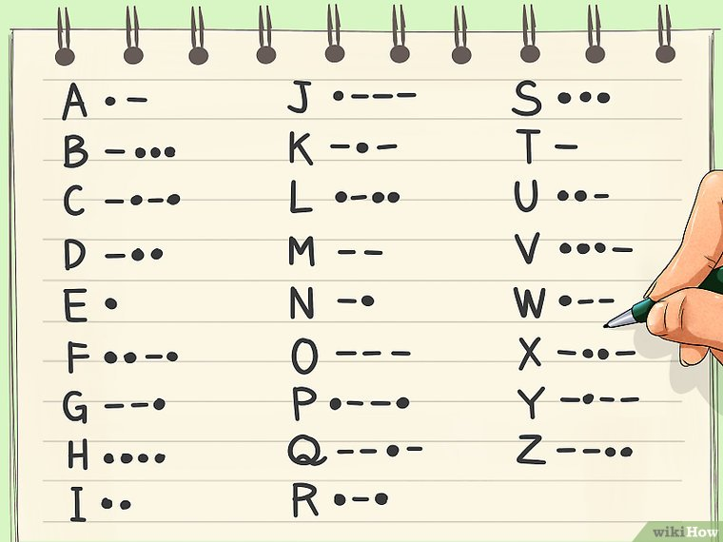
How do we communicate with sound without talking?
This is a good video to start learning about communicating with light and sound:
https://www.youtube.com/watch?v=Er0lHlXVCIE
Ask students if there are ways we communicate with sound without talking?
(sirens, smoke alarm, alarm clock, car horn, whistle, dog bark)
2. Go outside, watch TV, or go for a drive and see if kids can hear ways we communicate
with sound without talking. Have a discussion on how effective it is and what some
of the problems might be with that way of communicating. (If you are too far away you might
not be able to hear it. If you have hearing problems you won’t hear the message or warning.)
Another option is to introduce students to Morse Code.
Dr. Binocs introduces code: https://www.youtube.com/watch?v=ORIDAmGf_yQ
Crayola – a cute page of code: http://www.crayola.co.uk/free-coloring-pages/print/morse-code-message-coloring-page/
https://www.wikihow.com/Learn-Morse-Code#/Image:Learn-Morse-Code-Step-2-Version-4.jpg

Slide 3
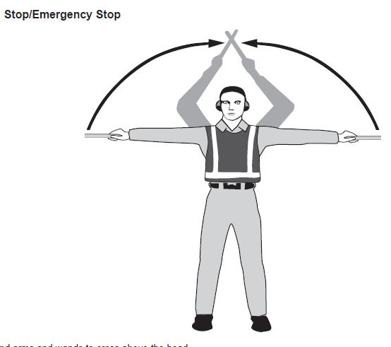
How do we communicate with light without talking?
https://studyflying.com/marshalling-hand-signals-for-aircraft/
Ask students if there are ways we communicate with light without talking?
(light house, air marshalling, sirens, alarms, stop lights)
2. Go outside, watch TV, or go for a drive and see if kids can hear ways we communicate
with light without talking. Have a discussion on how effective it is and what some
of the problems might be with that way of communicating. (If you are too far away you might
not be able to see it. If you have sight problems you won’t see the message or warning.)
Another option is to introduce students to Air Marshalling which is how pilots know how to park
their planes.
Video: https://www.youtube.com/watch?v=7siioLHPigg
Signals used: https://www.pinterest.com/pin/317433473705795701/ (see next slide)

Slide 4
